Slide 1

Dose of Cleanliness
Team 9

Slide 2

Problem
The attitude of people towards recycling
Lack of space
Unpleasant smell
43%
Recycle
Not recycle

Slide 3
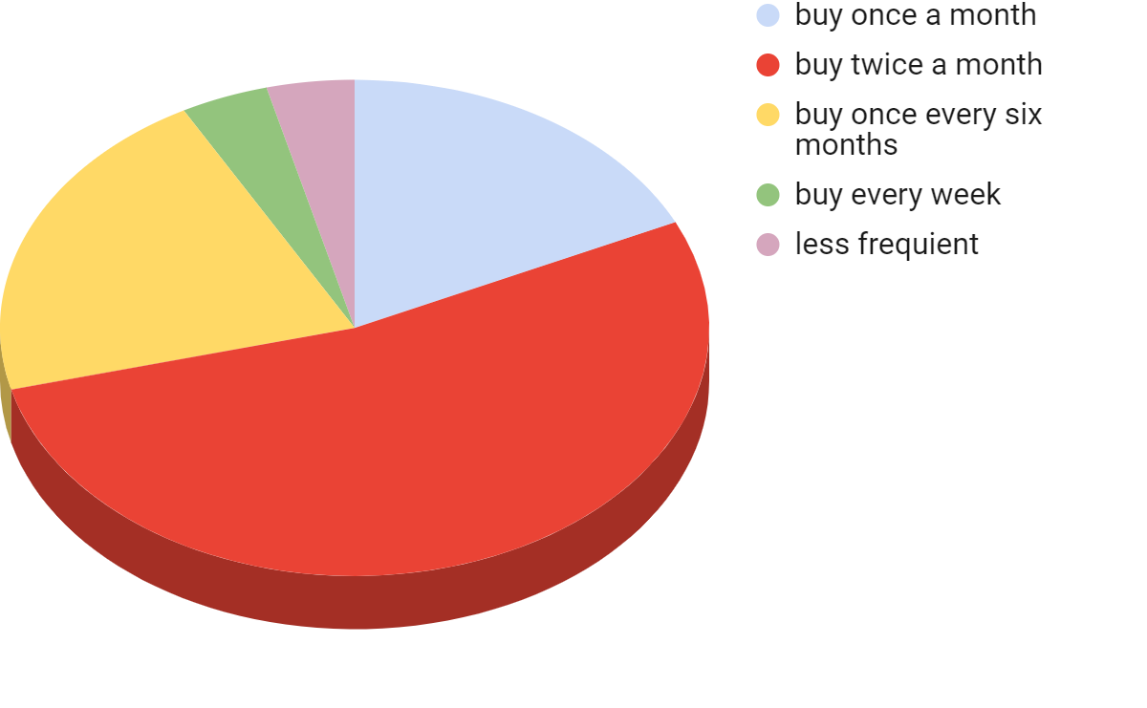

4%
4%
18%
21%
53%

Slide 4
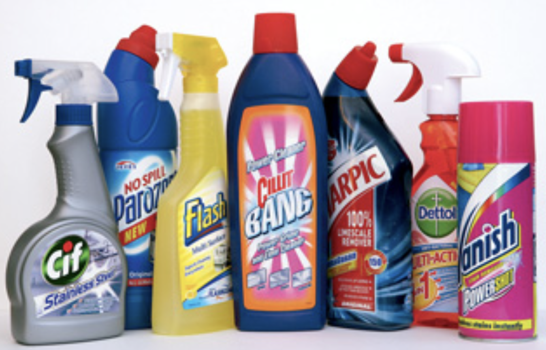
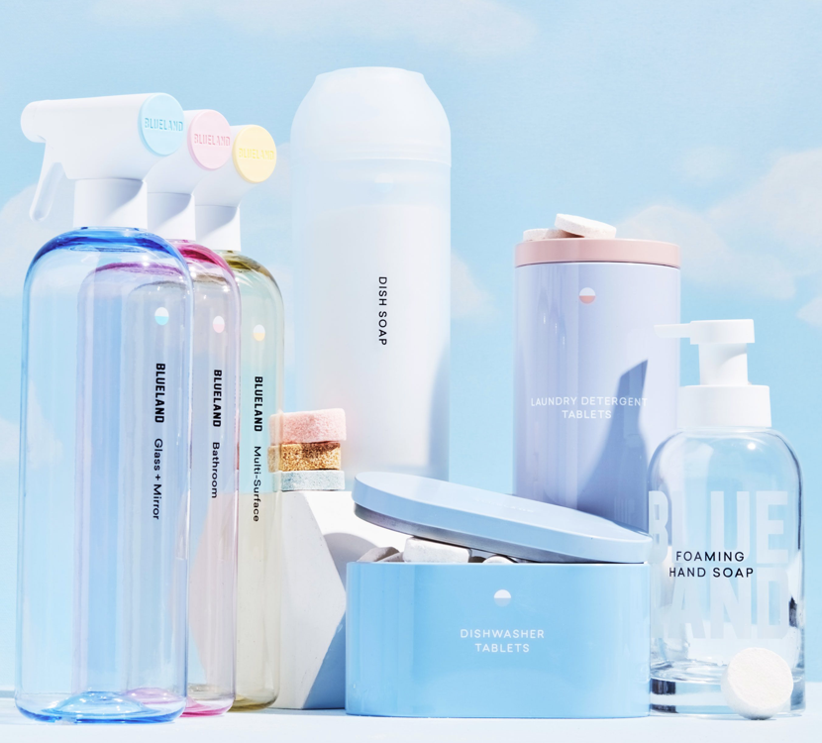
Current Solutions From The Competitors:
Already established cleaning brands:
Based on 80% - 90% water 20% - 10%
offer concentrated bottles of a cleaning supply
include harsh chemicals
high price (price range: 6BGN - 10BGN)
Emerging pill-based chemicals on the Bulgarian market
They are foreign brands
Different mechanism
Not sustainable

Slide 5
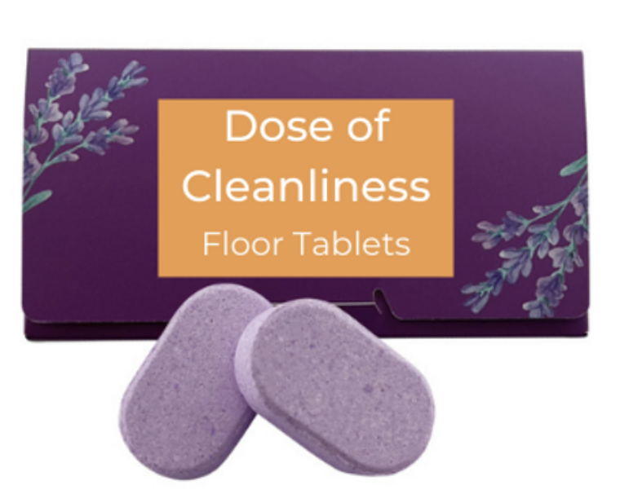
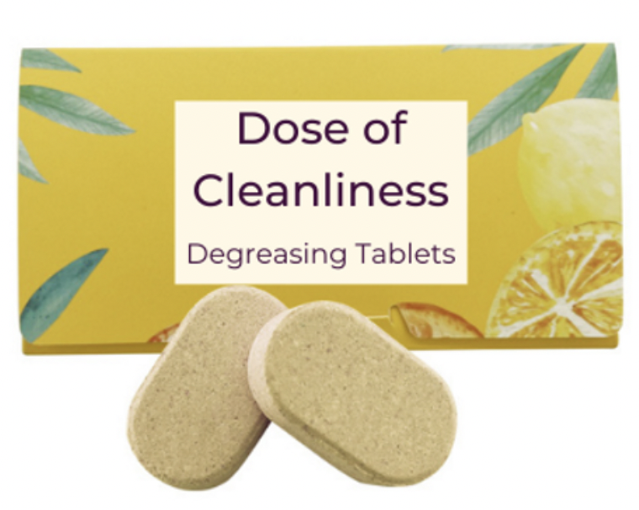

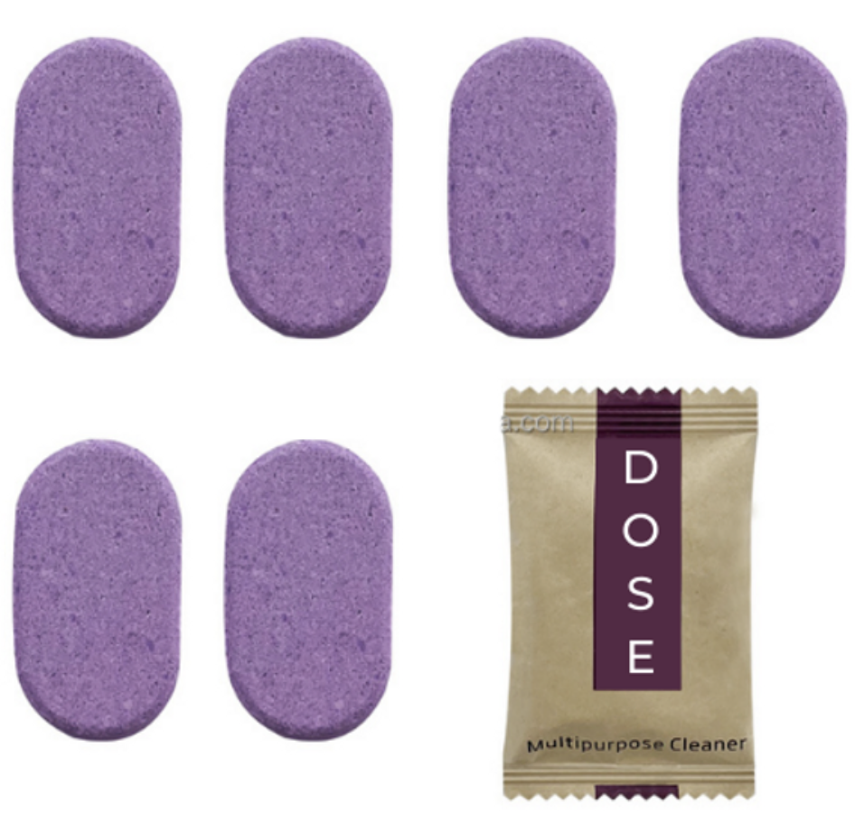
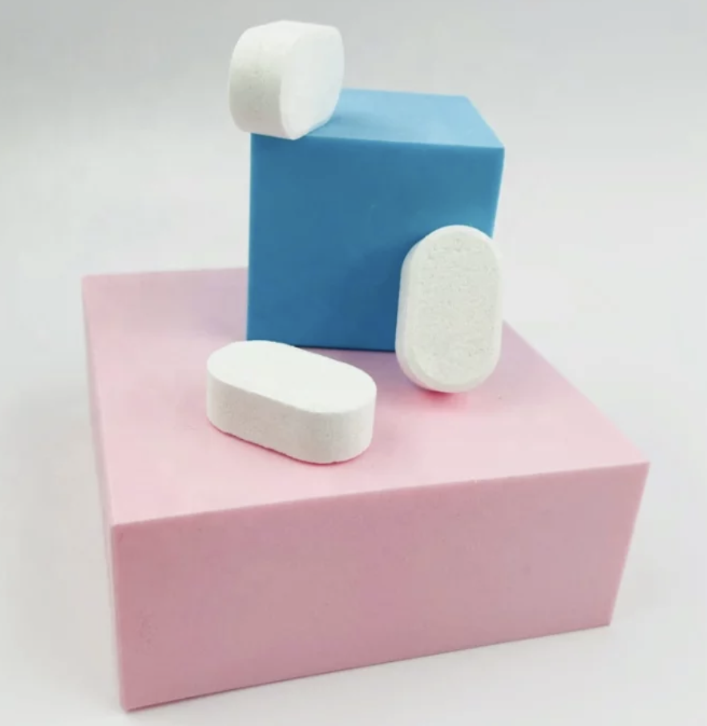
How are we better?
The bottle
Floor tablets
Bathroom tablets
Multi-purpose tablets
Mirror and glass tablets

Slide 6

Benefits
Time saving
Practical
Efficiency
Variety of smells
Reusable packaging
Sustainable

Slide 7
Business layers
Core product
Augmented product
Actual Product
Efficient
Eco-friendly
Appealing
Affordable
Pleasant smell
Cleaning product

Slide 8


Target
Maria
29 years old
Sofia, Bulgaria
Lawyer medium to high income
Married with a newborn baby
Keen on cleaning
Appreciates eco-friendly products and a world with minimum waste
Momchil
20 years old
Blagoevgrad
AUBG student
Lack of finances
Lazy, but has to keep the dorm clean
Eco-friendly person

Slide 9
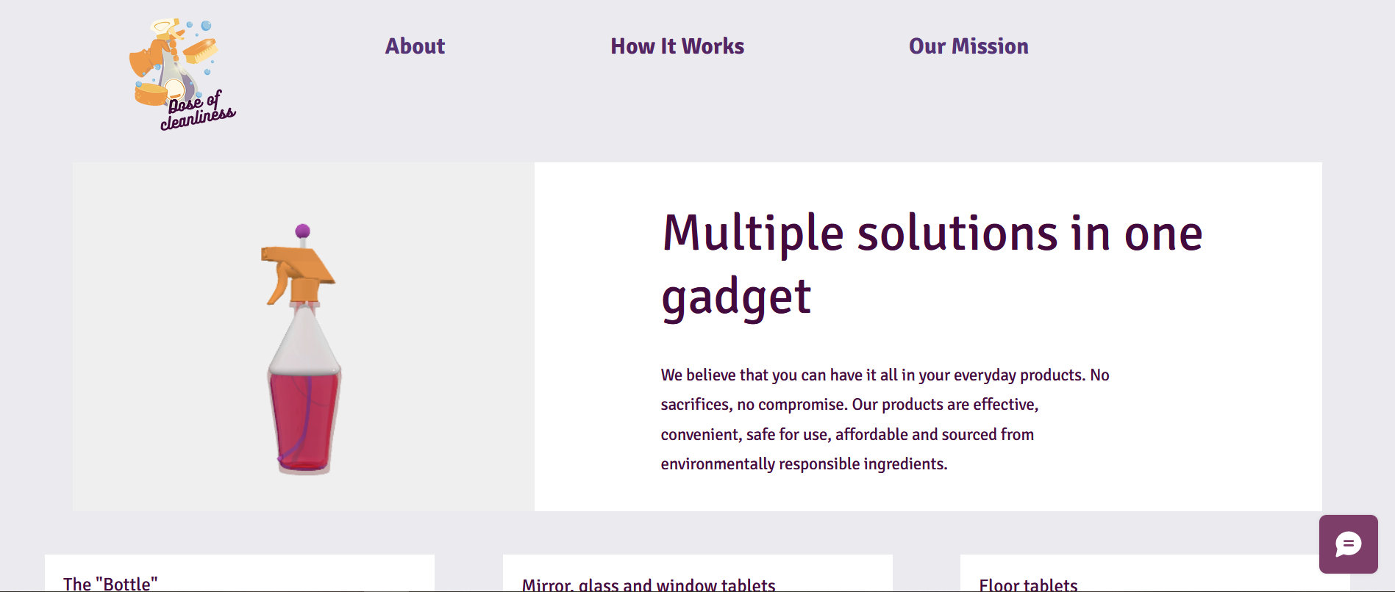
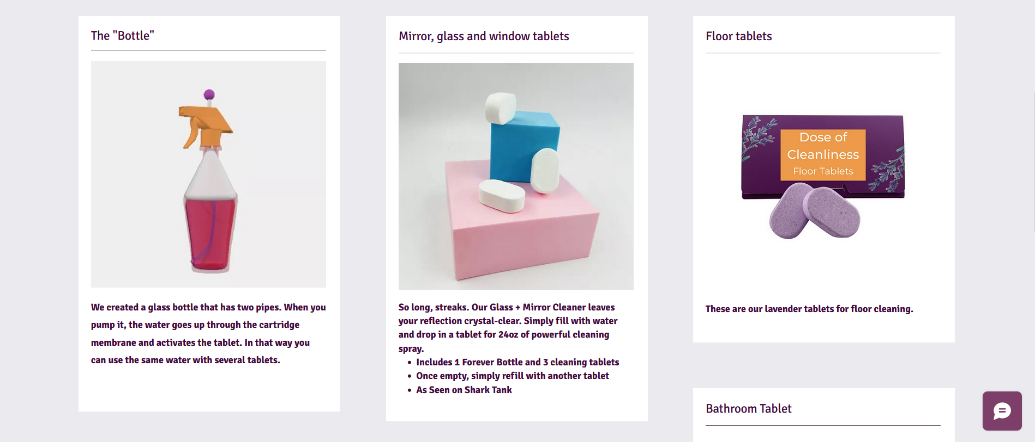
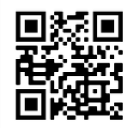

Slide 10
Estimated resources
Money:
For the website - 5 000 BGN
For marketing- 1 500 BGN
Legal services- 200 BGN
For bottles- 100 x 1.50 = 150 BGN
For tablets- 1000 x 0.11= 110 BGN
Shipment - 500 BGN
Total: 7 460 BGN
People:
Marketing guru
Website developers
Sales representatives
Product developers

Slide 11

How do we make money?
Cost of production:
1 bottle = 2. 30 BGN
5 pills in a box= 1. 55 BGN
Profit margin
Discount model
Retail prices:
1 bottle = 20 BGN
5 pills in a box= 7 BGN
So our profits:
From 1 bottle = 17. 70 BGN
From 1 box= 5.45 BGN
From 100 bottles = 970 BGN
From 100 boxes = 545 BGN

Slide 12
Road Map
Future implementations
Test period
December 2022
Production
2 Months
1 Month- 100 sold bottles
Website Development, Marketing
Break even
525 sold bottles
1 Month
November 2022

Slide 13
Distribution strategy
Frequent discounts on the website
The more you buy, the better the price become.
Discounts
Loyalty
Influencers
One time discount code

Slide 14
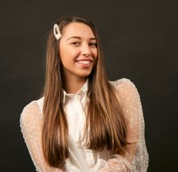
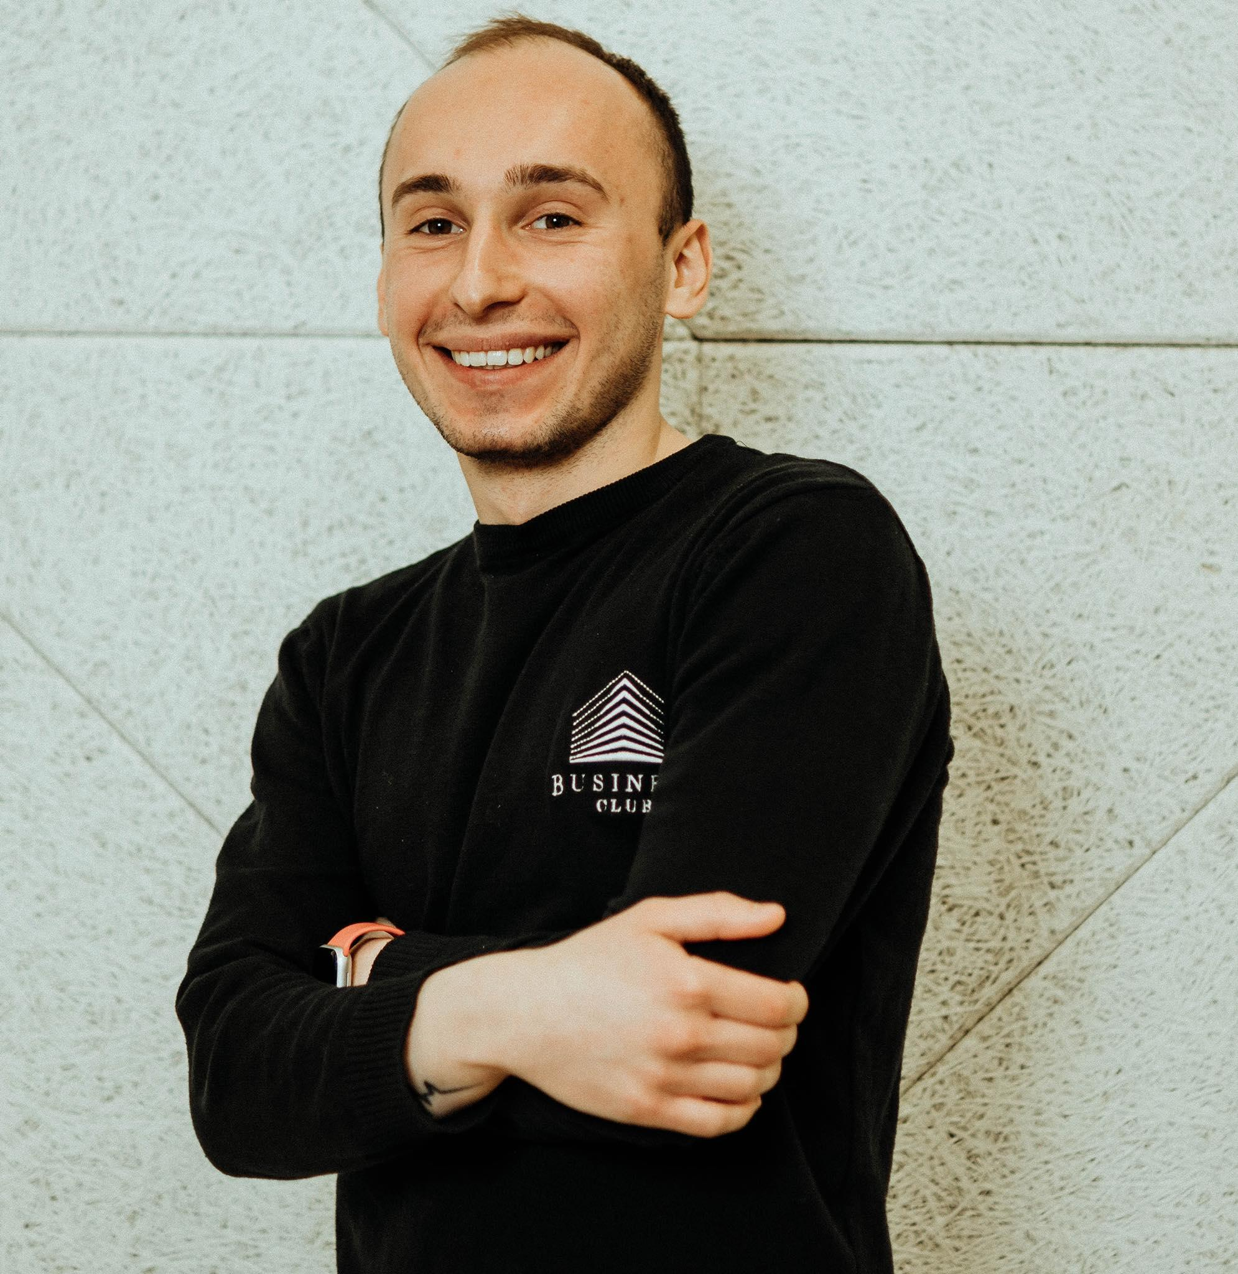

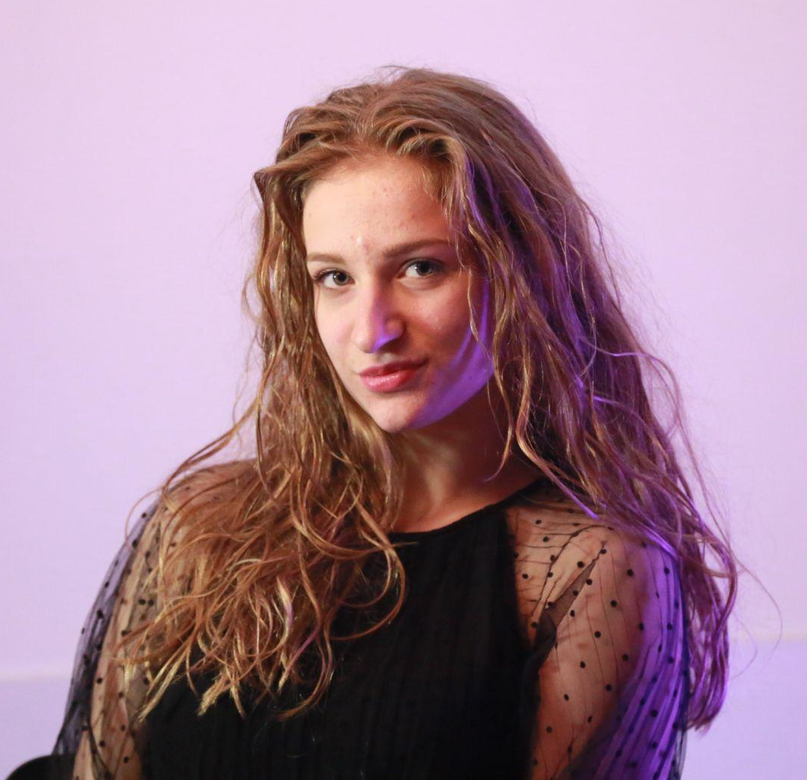
Meet the Team
Boyana Chopeva
Georgi Musev
Elena Ivanova
Mariela Nikolova
Marketing Guru
Communication Officer
Coordinator
Business Developer

Slide 15
Thank you for your attention!

